Slide 1
Continuous Deliver and Mircoservices
Building and Deploying Cloud Native Apps

Slide 2

CLOUD NATIVE
Agile
Lean
Continuous
Delivery
Microservices
Cloud
DevOps

Slide 3
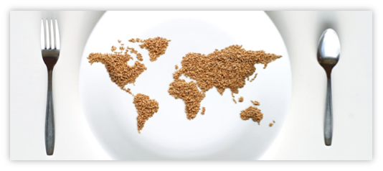
“Software is Eating the World”
Notes:
You’ve probably seen this slide before…but it’s worth revisiting
Stable industries that have had entrenched leaders are rapidly being disrupted, and they’re being disrupted by businesses with software at their core.

Slide 4



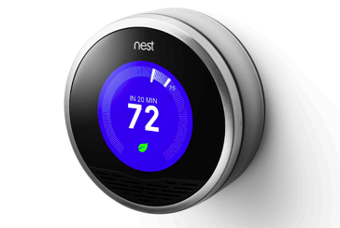


Is There a Pattern?
$3.5B valuation
Financial Services
$3.5B valuation
Transportation
$20B valuation
Entertainment
$3.5B valuation
Travel & Hospitality
$3.2B Acquisition by Google
Home Automation
$26B valuation
Tesla - Automotive
Notes:
Here’s a few of those industries…

Slide 5

SPEED

Slide 6

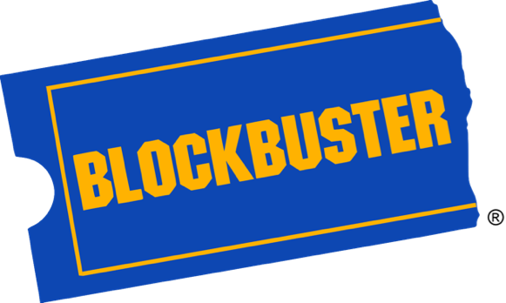
A Tale of Two Companies

Slide 7
SAFETY

Slide 8
Safety?
Visibility
Fault Isolation
Fault Tolerance
Automated Recovery

Slide 9
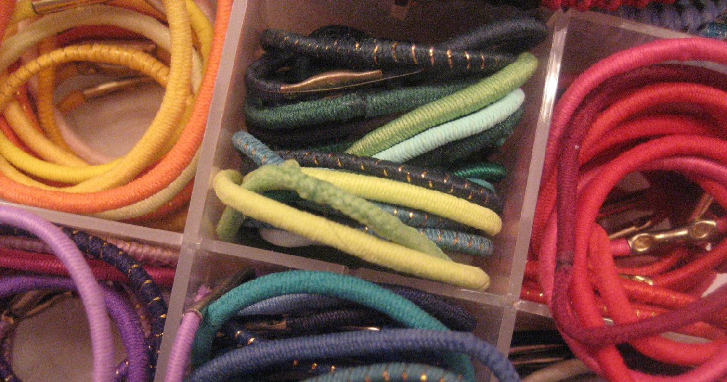
SCALE

Slide 10
Horizontal Scale
Slow/Expensive
Fast/Cheap
Notes:
Scaling used to be accomplished vertically…very slow (must minimally reconfigure/reboot virtual machines or physically reconfigure racked hardware) and expensive.
The big players (google, facebook, netflix, etc.) accomplish scale via horizontal scale on commodity hardware. Usually via containers/lightweight VMs.

Slide 11
But what is
Cloud-Native Architecture?

Slide 12
The promise of Cloud Native
Deploy new features daily to production
Automate middleware
Free/Cheap horizontal scaling
Contract between App & Platform
Notes:
That is and should be a governing principle behind any cloud platform, library, or tool. Spring Cloud–an open-source library–makes it easy to develop JVM applications for the cloud. With it, applications can connect to services and discover information about the cloud environment easily in multiple clouds such as Cloud Foundry and Heroku. Further, you can extend it to other cloud platforms and new services.
Application Framework
Spring Cloud : used by Netflix
Spring Boot now over 1M downloads a month, historic levels of growth
Runtime platform
Cloud Foundry elastic runtime used by top FS leaders
Enterprise production ready Linux Container based platform
Infrastructure Automation
CF BOSH: Embedded OS, cloud API integrated
Incredible operational leverage; machine to machine automation

Slide 13


Cloud Native Architecture
1. Application Framework
Developer
Contract
2. Container Runtime
Dev+Ops
Contract
3. Infrastructure Automation
IT Ops
BOSH
“Contracts” between Applications, opinionated frameworks like Spring Boot and Spring Cloud and opinionated Cloud Native Platforms like Cloud Foundry help significantly accelerate the development of Cloud Native applications
Notes:
That is and should be a governing principle behind any cloud platform, library, or tool. Spring Cloud–an open-source library–makes it easy to develop JVM applications for the cloud. With it, applications can connect to services and discover information about the cloud environment easily in multiple clouds such as Cloud Foundry and Heroku. Further, you can extend it to other cloud platforms and new services.
Application Framework
Spring Cloud : used by Netflix
Spring Boot now over 1M downloads a month, historic levels of growth
Runtime platform
Cloud Foundry elastic runtime used by top FS leaders
Enterprise production ready Linux Container based platform
Infrastructure Automation
CF BOSH: Embedded OS, cloud API integrated
Incredible operational leverage; machine to machine automation

Slide 14
1. Application Framework
Spring
#1 Enterprise Java App Framework
Netflix
Open Source
Spring Boot
Quick Start
Little to no config.
Opinionated View
Spring Cloud
Distributed Config
Service Registration and Discovery
Routing/Load Balancing
Service Integration
Fault Tolerance
Pivotal is the main custodian of Spring and we hire the main committers for Spring Boot and Spring Cloud. We can bring these resources to bear to help significantly accelerate a customer’s journey to becoming a Cloud Native enterprise
Notes:
#1 Enterprise Java App Dev Framework
Used heavily by Netflix and F2000
OSS, Apache 2.0 licensed
Millions of downloads
Integrated into PCF, BDS

Slide 15
DEFINE: Micro Service
If every service has to be updated in concert, it’s not loosely coupled!
Loosely coupled service oriented architecture with bounded contexts
If you have to know about surrounding services you don’t have a bounded context.
Notes:
Often rest/http, lightweight container
Domain Driven Design applied in a new way
http://martinfowler.com/articles/microservices.html#AreMicroservicesTheFuture
http://highscalability.com/blog/2014/4/8/microservices-not-a-free-lunch.html

Slide 16
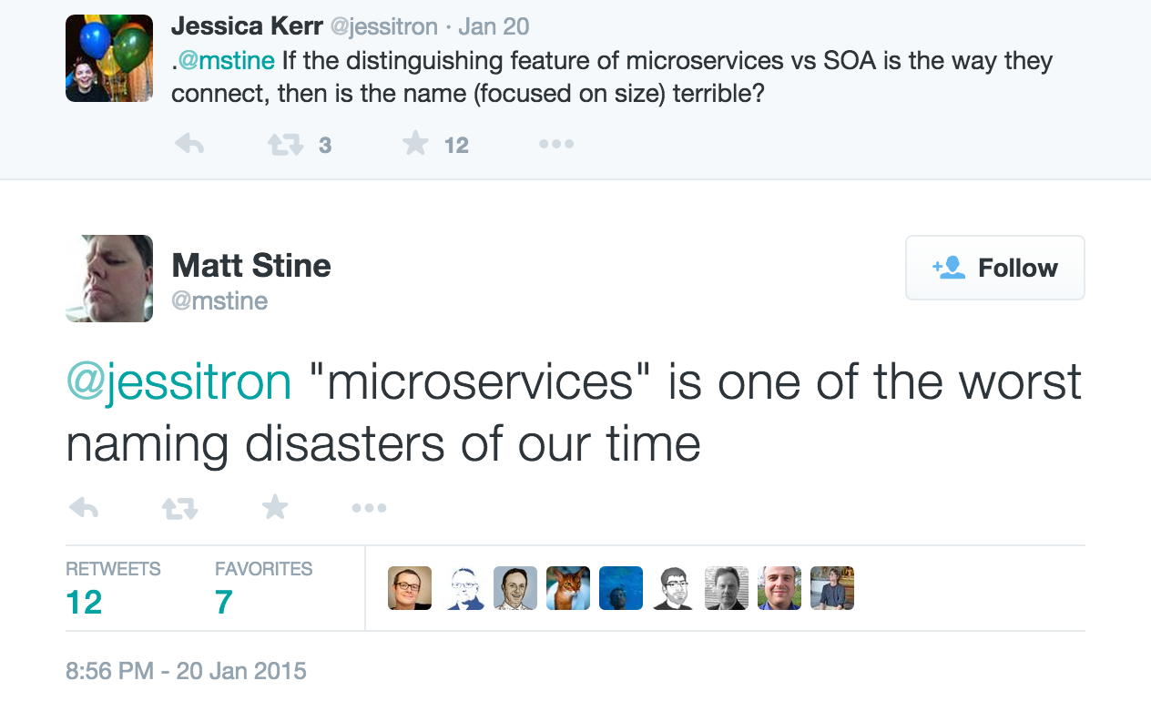
https://twitter.com/mstine/status/557763539101032448
Notes:
Qualitative (focus, role, capability) vs. Quantitative (lines, operations, endpoints)

Slide 17


Not Monoliths
HTML
JavaScript
MVC
Service
Service
Data Access
Browser
Monolithic Application
Relational Database
Notes:
Of course none of this is true in the traditional monolith

Slide 18
Not Traditional (ESB-centric) SOA
UI
Service
Service
Service
Service
UI
Enterprise Service Bus
Service
Service
Service
Service
Notes:
Nor is it true here either…
Essentially trading one monolith for another
Trying to hide essential complexity behind accidental complexity…shoving it into a box

Slide 19
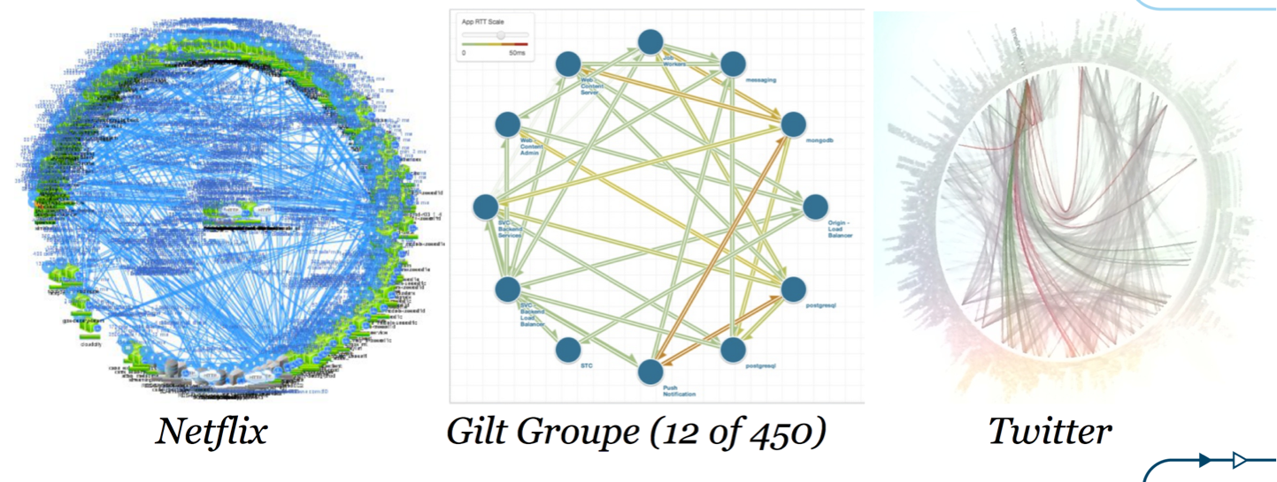
But Microservices!
From: http://www.slideshare.net/adriancockcroft/goto-berlin
Notes:
A graph
one which reveals the true nature of things
and yet this architecture of revealed complexity is at the heart of the fastest moving, most innovative companies in the industry

Slide 20





Microservice Architecture
Relational
DB
HTTP
HTTP
Key/Value
Store
HTTP
HTTP
HTTP
…
AMQP
AMQP
HTTP
Graph
DB
Notes:
REST and message-driven services
Polyglot persistence, services encapsulate data store semantics
Diversity of clients acknowledged
API Gateway for service aggregation, reduce chattiness, protocol translation, reduce latency/round-trips, deal with mobile device fragmentation, build use case/device specific API’s

Slide 21
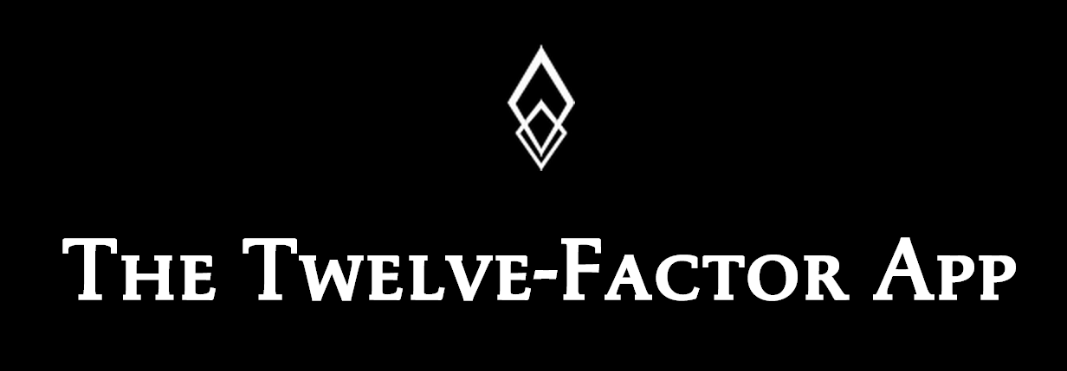
http://12factor.net/

Slide 22
Challenges of Distributed Systems
Configuration Management
Service Registration & Discovery
Routing & Load Balancing
Fault Tolerance (Circuit Breakers)
Monitoring
Concurrent API Aggregation & Transformation
Notes:
Everybody faces these, SCS takes PCF to the next level

Slide 23
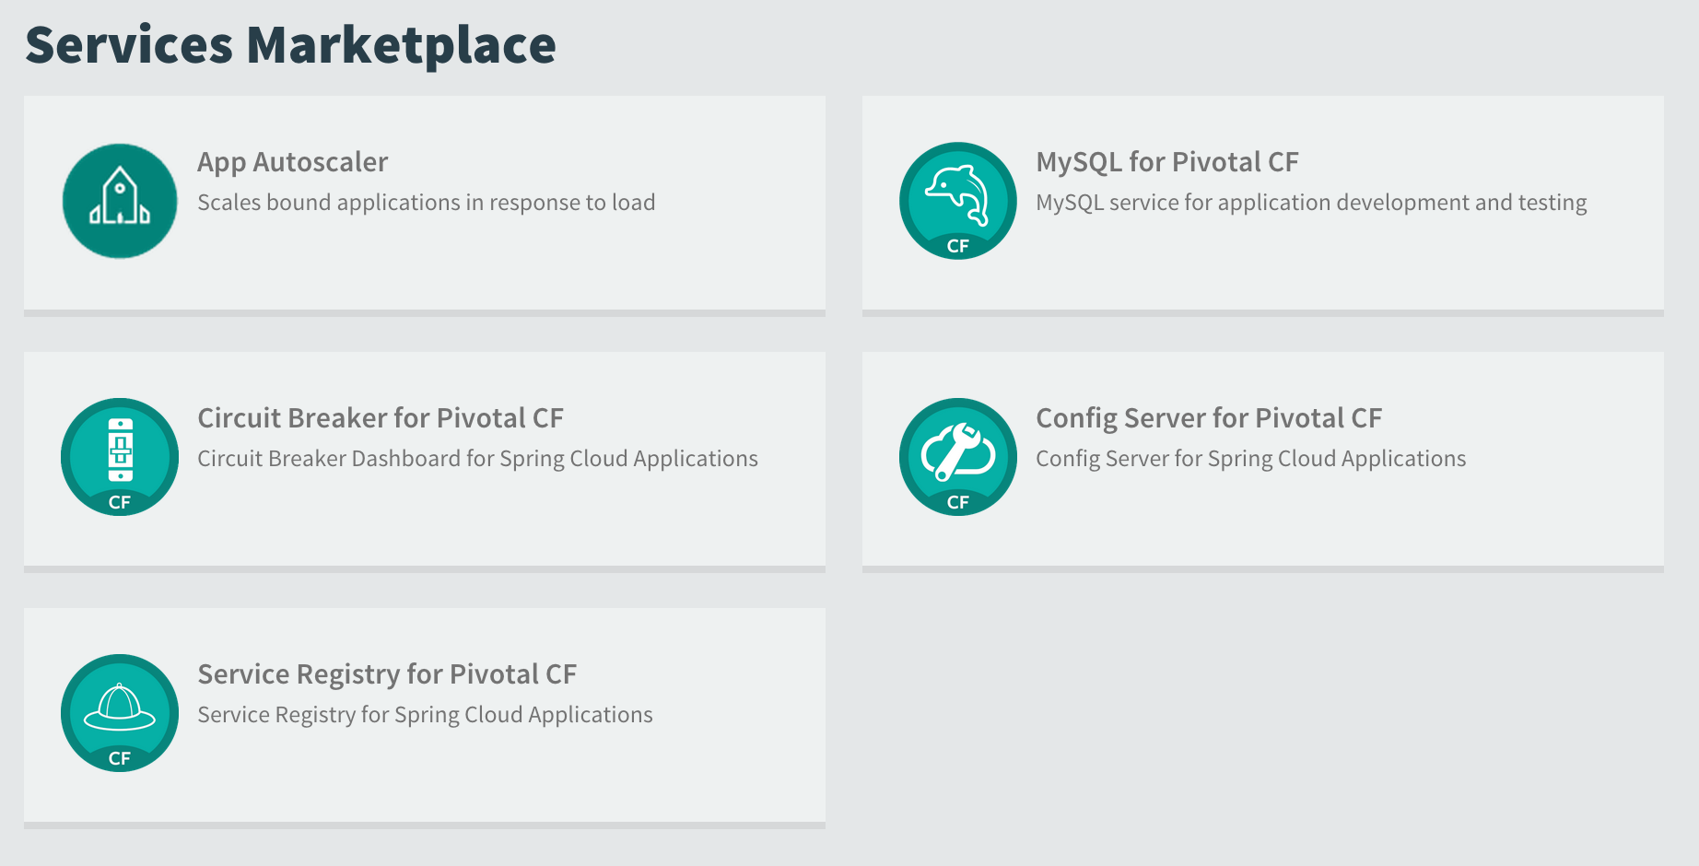


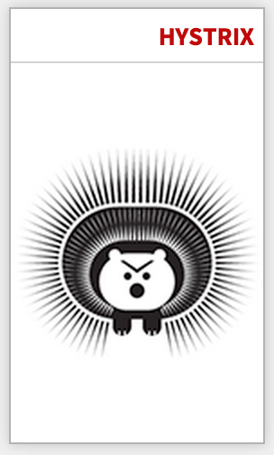

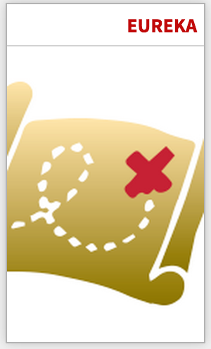
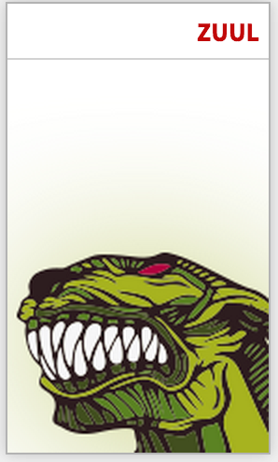


μServices
with
In-App Support Libraries
Bindable Services

Slide 24




Spring Cloud
Notes:
http://www.wired.com/wp-content/uploads/2014/06/google-cloud.jpg

Slide 25

Companies want to be fast like Netflix
Netflix needed to be faster to win / disrupt
Pioneer & vocal proponent of microservices - the key to their speed and success
Netflix OSS supplies parts, but it’s not a solution
Difficult for enterprises to build it themselves
Pivotal offers the closest thing to “Netflix in a box” today
“
“Velocity on the JVM is the Killer App”
- Andy Glover (Netflix Eng) @ SpringOne2GX 2014 Keynote
https://youtu.be/xU267-YHN5c?t=1938
Notes:
NetFlix, an undisputed business & technology leader
34% of peak N. American internet traffic from 6-9pm
If speed was why they won, microservices was how
They pioneered / began to popularize micro service concept
All they had was Amazon EC2 back then
They had to invent a distributed platform, cloud native platform with PaaS – like features
They had to invent microservice infrastructure at the application level
All before writing one line of code that relates to the application you and I know as Netflix
NetflixOSS is a talent acquisition and retention strategy, they are in the movie business 1st, and the software business 2nd.
Open source and supporting their developer’s efforts in the industry is how they are able to attract and retain the best engineers, giving them the ability to invent all this stuff.
That’s tough to duplicate.
Detail on Netflix quote: Netflix needed the performance, stability, concurrency of the JVM, but was searching the right RAD capability to give them the velocity they wanted.

Slide 26


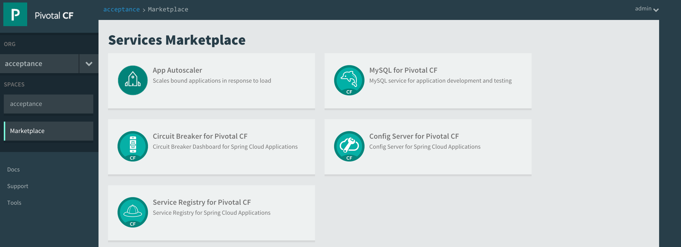

Spring Cloud Services Suite
Installed via Pivotal Ops Manager
Adds all services to Pivotal Cloud Foundry Marketplace
Config Server
Service Registry
Spring Cloud
Services
Circuit Breaker Dashboard
Notes:
ONE CLICK INSTALL
1 config server AI
2 AIs for eureka (for F/T)
2 Ais for Turbine
1 SI for turbine (Rabbit perhaps for pub/sub to hystrix dashboard?)
1 SI for svc broker (mysql) for config server?

Slide 27
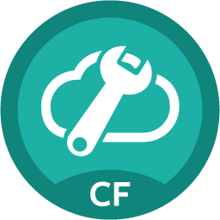
Spring Cloud Config Server
Spring Cloud Config Server
Service Binding via Spring Cloud Connector
Git URL for Config Repo provided via Service Dashboard (post-provisioning)
Single tenant, scoped to CF space (nothing prevents shared Git repo)
Config Server
Notes:
ASK

Slide 28
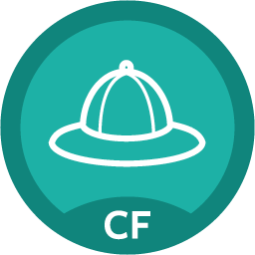
Spring Cloud Service Registry
Service Registration and Discovery via Netflix OSS Eureka
Service Binding via Spring Cloud Connector
Single-tenant, scoped to CF space
Registration via CF Route
PCF 1.4.1 (Q2 ’15): Support Direct Address (“promiscuous”) Mode
Service Registry
Notes:
Ask
Consul, Zoookeeper

Slide 29

Spring Cloud Circuit Breaker
Netflix OSS Turbine + Hystrix Dashboard
Aggregation via AMQP (RabbitMQ)
Binding via Spring Cloud Connector
Single-tenant, scoped to CF space
Circuit Breaker
Dashboard

Slide 30


Self-Service Agile Infrastructure
Platform
Services
Spring Cloud
Notes:
While microservices are simple, they are certainly not easy [1]. It's recently been said that "microservices are not a free lunch" [2]. Interestingly enough, if you look at the concerns expressed here about microservices, you'll find that they are *exactly* the challenges that a PaaS is intended to address. So while microservices do not necessarily imply cloud (and vice versa), there is in fact a symbiotic relationship between the two, with each approach somehow compensating for the limitations of the other, much like the practices of eXtreme Programming do the same [3].

Slide 31
What does
the journey look like?

Slide 32

What is Continuous Delivery?
Development
Business
Operations
Customer
$
QA
Notes:
Driven from Lean -> Concept to Cash
Taichi Ohno - reducing the timeline by removing the non-value added wastes
SHRINK <Transition>

Slide 33
What is Continuous Delivery?
$
Notes:
So how do you do that?
By making the first task on any software effort “delivery” - deploy the code somewhere, even if it doesn’t do anything. You might call this a walking skeleton.
And then keep doing that every time you change anything…which primes the pump for real iterative feedback cycles

Slide 34
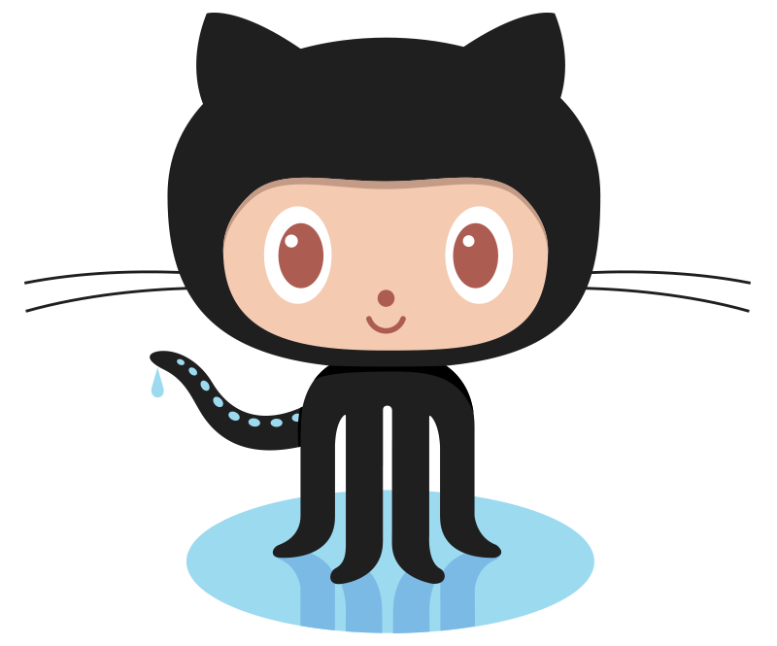

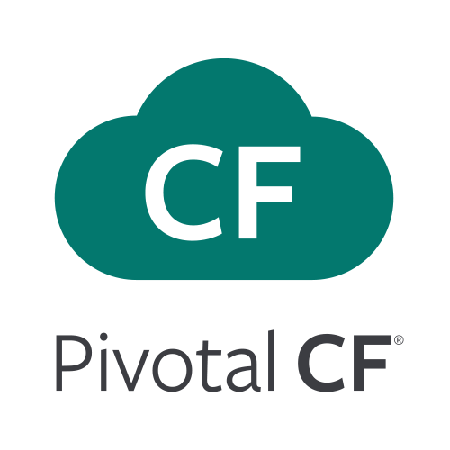

Continuous Integration & Delivery Delivery High Quality Software, Faster and Continuously From Idea to Production
AUTOMATION.
Integrate tools and automate processes from testing to builds and deployment
SPEED.
Release more frequently with smaller bits will reduce complexity and improve time-to-market
QUALITY.
Reduce feedback loop using test-driven development to surface problems sooner and be responsive
AGILITY.
Push updates on regular basis with no downtime to improve customer experience and time to market
Commit Code Change
Automate Build & Test
(Unit Test, Static Code Analysis)
Store Binaries & Build Artifacts
Automated Integration Testing
Acceptance, Performance & Load
Zero Downtime Upgrade to Production
Build Pipeline Operations
Tool Chain
GitHub
Jenkins
Development
Test + UAT + Staging
Production
Distributed revision control and source code management. Collaborative software development
Build and test software projects continuously and incrementally. Hundreds of compatible plugins
Share binaries and manage distributions. Manage artifact lifecycle. Avoid license violations
Develop, test, QA and production on the same platform. Simple, developer friendly commands and APIs. Operational benefits for every app. Built-in ecosystem services. Deploy, operate an scale on any IAAS

Slide 35
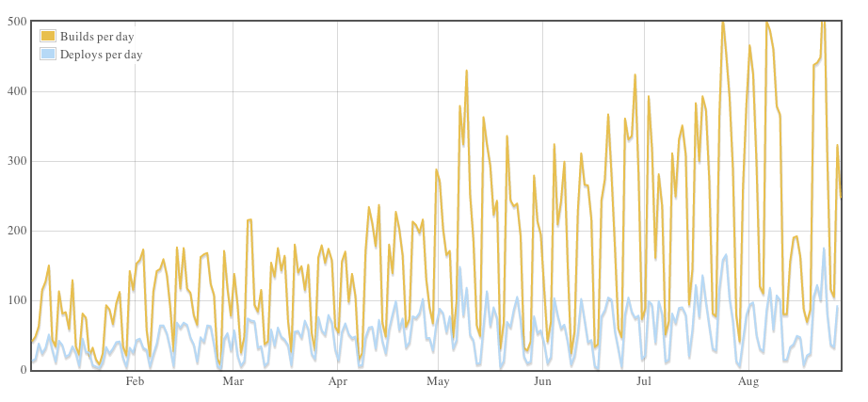
Continuous Deployment?
Github: On August 23, 2012 – 563 builds and 175 deploys

Slide 36
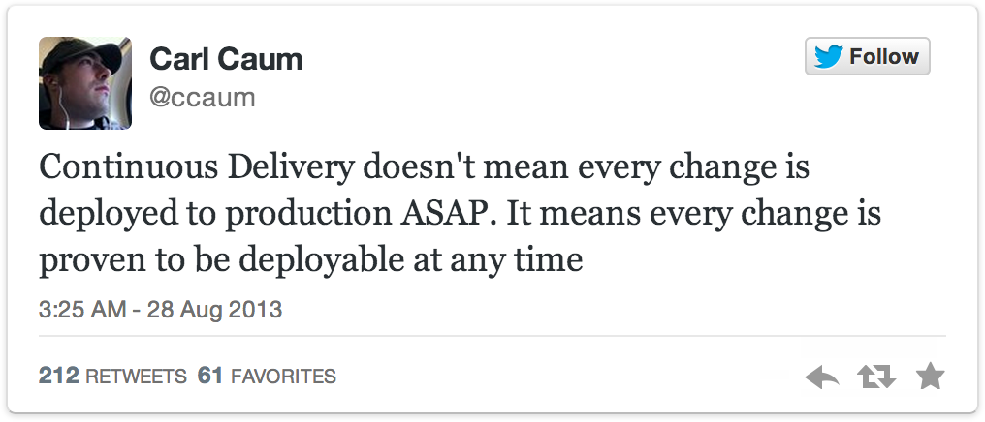
Continuous Delivery != Continuous Deployment
Notes:
So how do you do that?
By making the first task on any software effort “delivery” - deploy the code somewhere, even if it doesn’t do anything. You might call this a walking skeleton.
And then keep doing that every time you change anything…which primes the pump for real iterative feedback cycles

Slide 37




Prod
Release
#1
Prod
Release
#2
Waterfall
Organization!
Agile Development
Prod
Release
#3
Notes:
frustrating bit - when we try to do this within that water-scrum-fall type organization that Sam mentioned this morning
we batch up multiple iterations
business is not seeing a steady stream of value
development isn’t getting the benefit of continual course correction

Slide 38
Keep the Wheel Spinning!
Customer
Feedback
Design
Develop
Test
Customer
Delivery
Analytics
Notes:
We don’t just demo to the customer but we actually deliver to the customer - in production
Push out the iteration cycle from a stories to demo cycle to a stories to production deployment cycle
Gain real feedback from real customers: what they say as well as how they behave (analytics)
And ultimately deliver the most value by ensuring that we’re actually building the right thing

Slide 39





Silo Delivery
Project Mgmt
UX
Dev
QA
DBA
Sys
Admin
Net
Admin
Storage
Admin
MONOLITHIC DELIVERY
Adapted from: http://www.slideshare.net/adriancockcroft/goto-berlin
Notes:
- development process may be agile “per se” - but we then enter traditional ticket-based systems and release cycles for changes to the supporting environment <TRIGGER>
silos protect their turf and optimize locally - making desired project actions — database schema changes, manual regression cycles, environment provisioning — difficult or impossible
- one of the reasons is this batching up of change increasing the perceived risks of delivery from each of the silos, so the knee jerk reaction is to prevent change because change breaks things…and the iterative cycle gets progressively slower and eventually stops.

Slide 40
Continuous Delivery
Product
Mgr
UX
Dev
QA
DBA
Sys
Admin
Net
Admin
Storage
Admin
BUSINESS CAPABILITY TEAMS
USING MICROSERVICES
PLATFORM OPERATIONS TEAM
Adapted from: http://www.slideshare.net/adriancockcroft/goto-berlin
Notes:
shift from PROJECTS to PRODUCTS
cross functional business capability teams — all roles necessary to build, test, deliver, operate services delivering that business capability — characteristics of microservices tend to right size systems to right sized teams and capabilities
platform operations team - provides self-service agile infrastructure to business capability teams - or the business capability of a fabric on which to deliver other business capabilities - that cloud-native application platform

Slide 41
Continuous Delivery
Product
Mgr
UX
Dev
QA
DBA
Sys
Admin
Net
Admin
Storage
Admin
Self
Service
API
BUSINESS CAPABILITY TEAMS
USING MICROSERVICES
PLATFORM OPERATIONS TEAM
Adapted from: http://www.slideshare.net/adriancockcroft/goto-berlin
Notes:
business capability teams consume the platform via self-service API’s
just as microservices communicate w/ each other via API’s, so does the microservice with its hosting platform

Slide 42
CATALOG
INVENTORY
Prod Release
Prod Release
Prod Release
Prod Release
Prod Release
Prod Release
REVIEWS
SHIPPING
Prod Release
Prod Release
Prod Release
Prod Release
Prod Release
Prod Release
Notes:
- leads to autonomous business capability teams that complete the entire concept to cash release cycle
teams are continuously deliver value around their capabilities, moving in an agile manner, responding to changes in the business, moving swiftly
able to form new teams specifically to innovate and experiment with new business models and ideas

Slide 43
Where do I start?

Slide 44

A little cloud book…
Available to you
compliments of Pivotal!
Get your FREE print copy
at the O’Reilly booth!
Or, get the FREE e-book
at http://bit.ly/cloud-native-book!

Slide 45
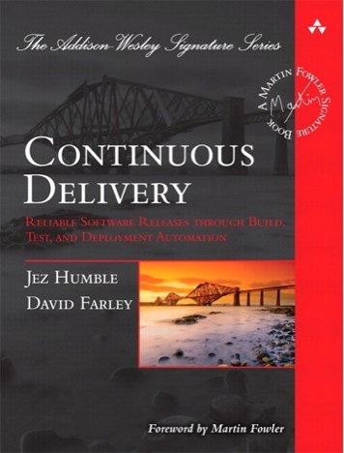
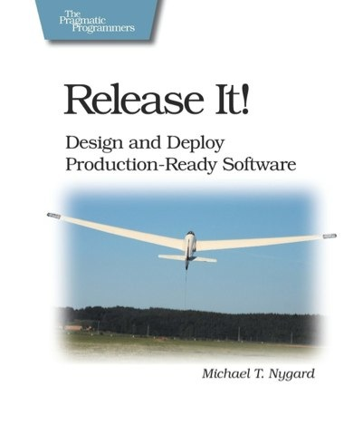
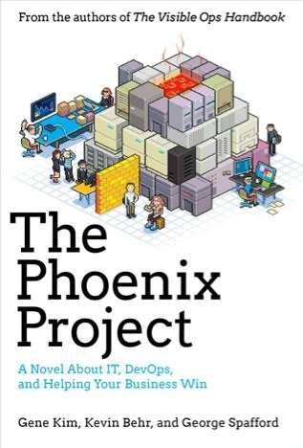
Foundations
Notes:
continuous integration of development changes
one package / many deploys
automation
deploy smaller batches more frequently
automate all testing where test failures would prevent prod release

Slide 46
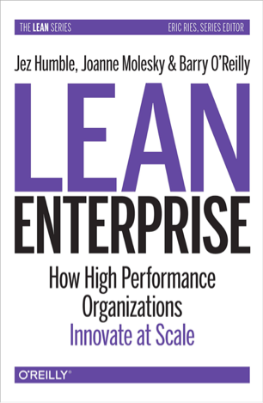

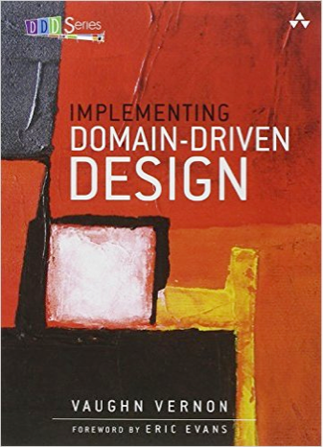
Foundations
Notes:
continuous integration of development changes
one package / many deploys
automation
deploy smaller batches more frequently
automate all testing where test failures would prevent prod release

Slide 47
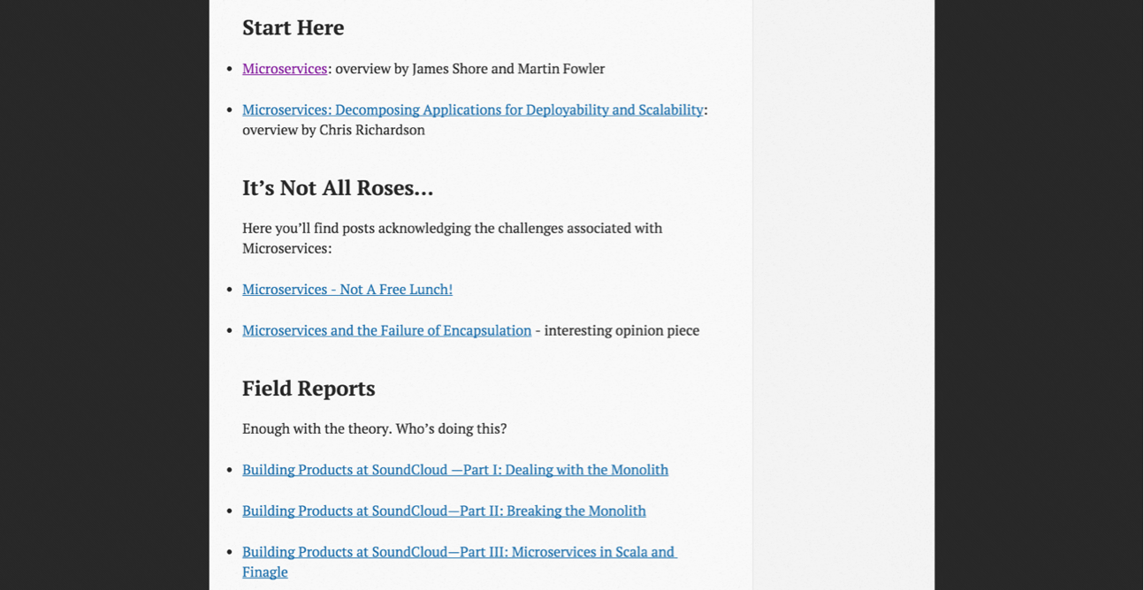
http://www.mattstine.com/microservices

Slide 48
Show me some code…
https://github.com/spring-cloud-samples/fortune-teller
https://github.com/spring-cloud-samples/springbox-cloud

Slide 49

https://2015.event.springone2gx.com/register

